Slide 1
Swift DocC
Generates your rich API reference document
Presented By: Sugeet Goyal - 24-02-2024

Slide 2

Covering
Existing Popular Tools
What is DocC ?
Why DocC ?
Creating
Theming
Hosting Documentation
Automate Builds
Shortcuts
QnA

Slide 3
Existing Popular Tools

Slide 4
Apple Docs
Provides a list of undocumented symbols so you know what’s missing
No release after 2015.
Not compatible with Swift.
Fixing & using unmaintained framework is not recommended.
Maintenance cost is higher.

Slide 5
Jazzy
Mixed Objective-C / Swift
“This feature is new and has some rough edges”, no updates since last 4 years.
Docs from .swiftmodules or frameworks
“This feature is new: there may be crashes and mistakes. Reports welcome.” No update since last 3 years

Slide 6
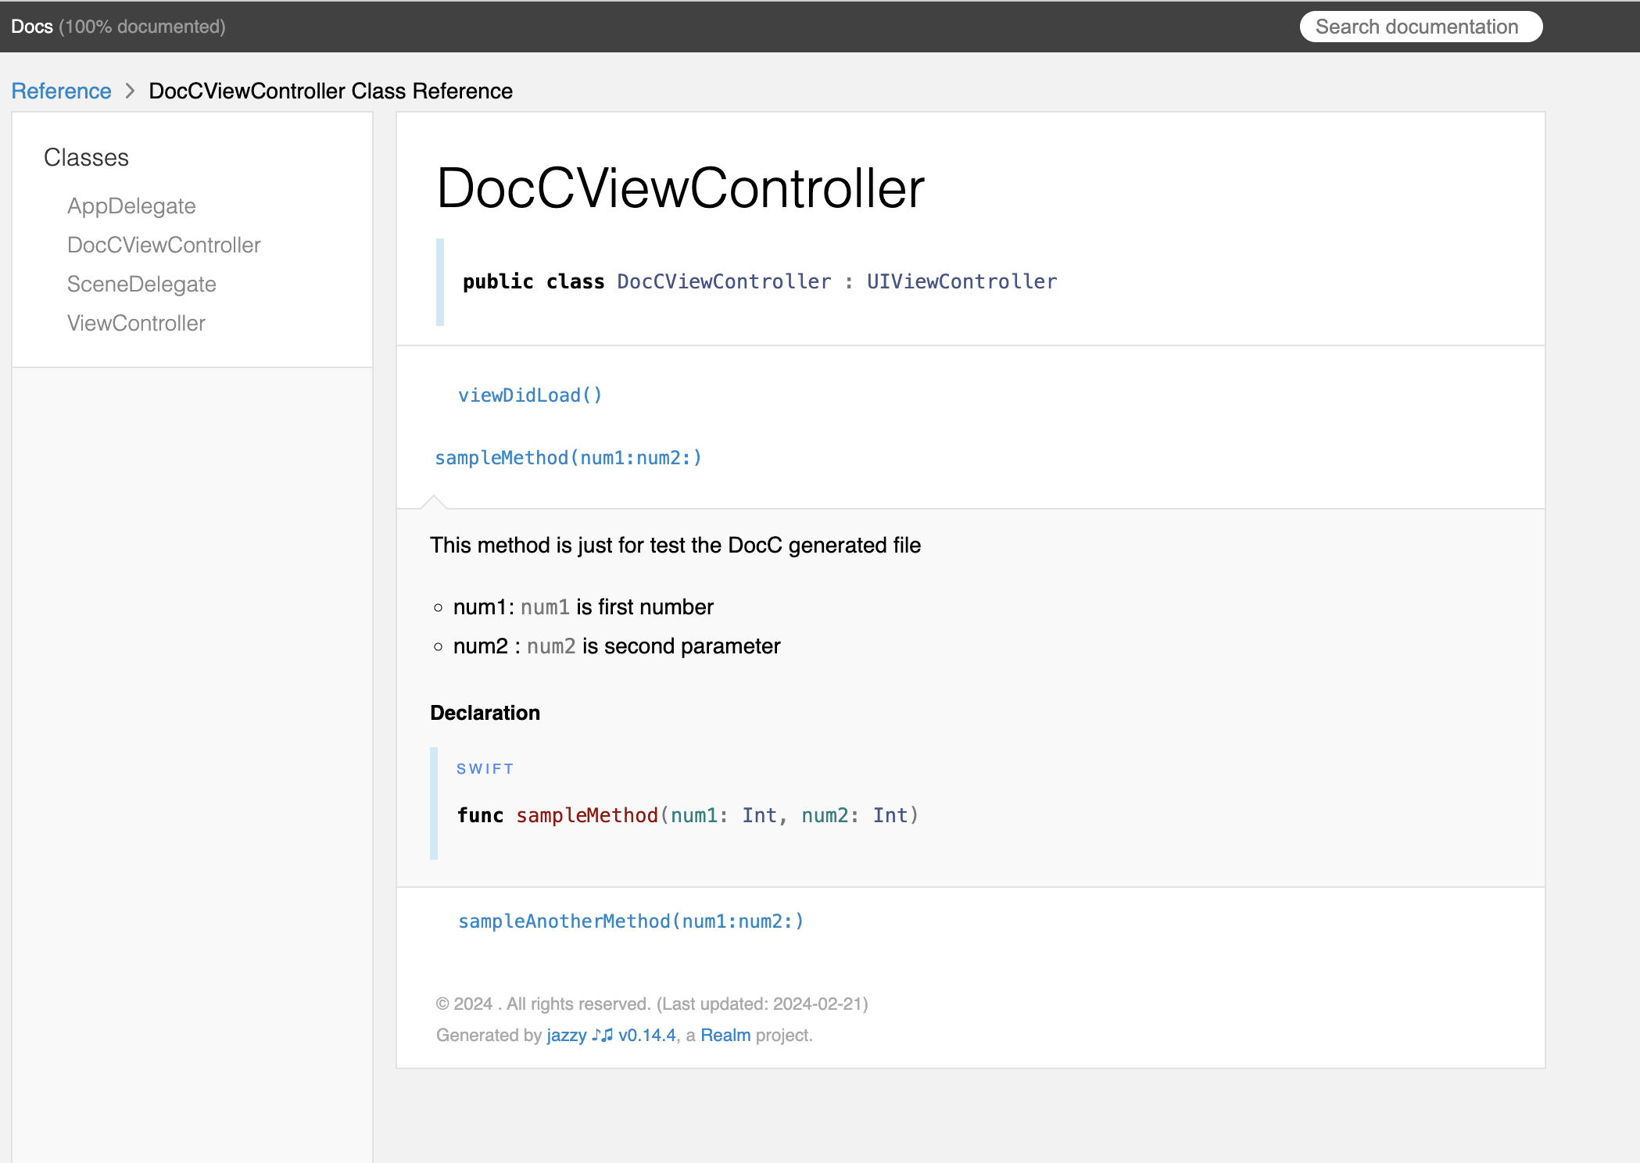
Jazzy
Run below command to generate jazzy doc jazzy --min-acl internal --xcodebuild-arguments -workspace,DOCCDemo.xcworkspace,-scheme,DOCCDemo

Slide 7
What is Swift DocC?

Slide 8
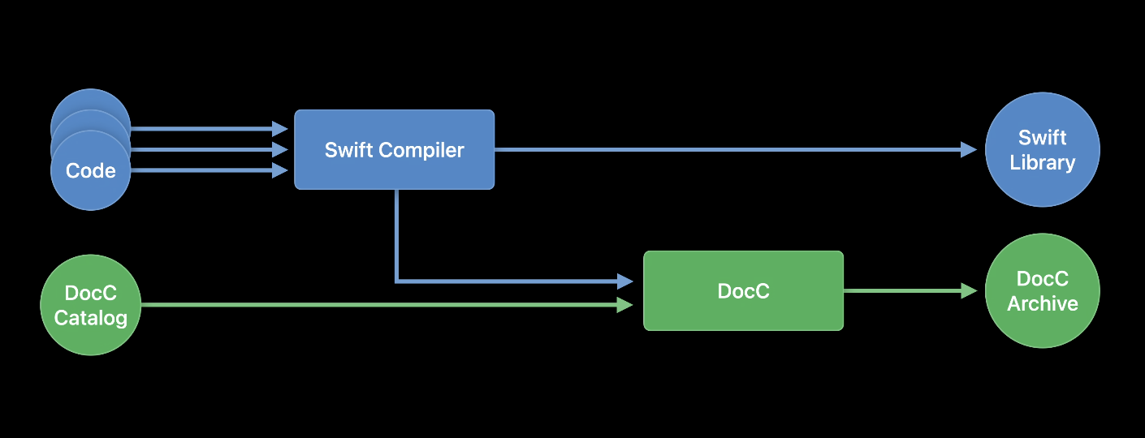
What is Swift DocC ?
Swift-DocC is a documentation compiler integrated directly into Xcode that allows you to write and publish rich documentation for your project right alongside your source code.
Produces good looking documentation. It presents it nicely and accurately, in both ObjC and Swift.

Slide 9
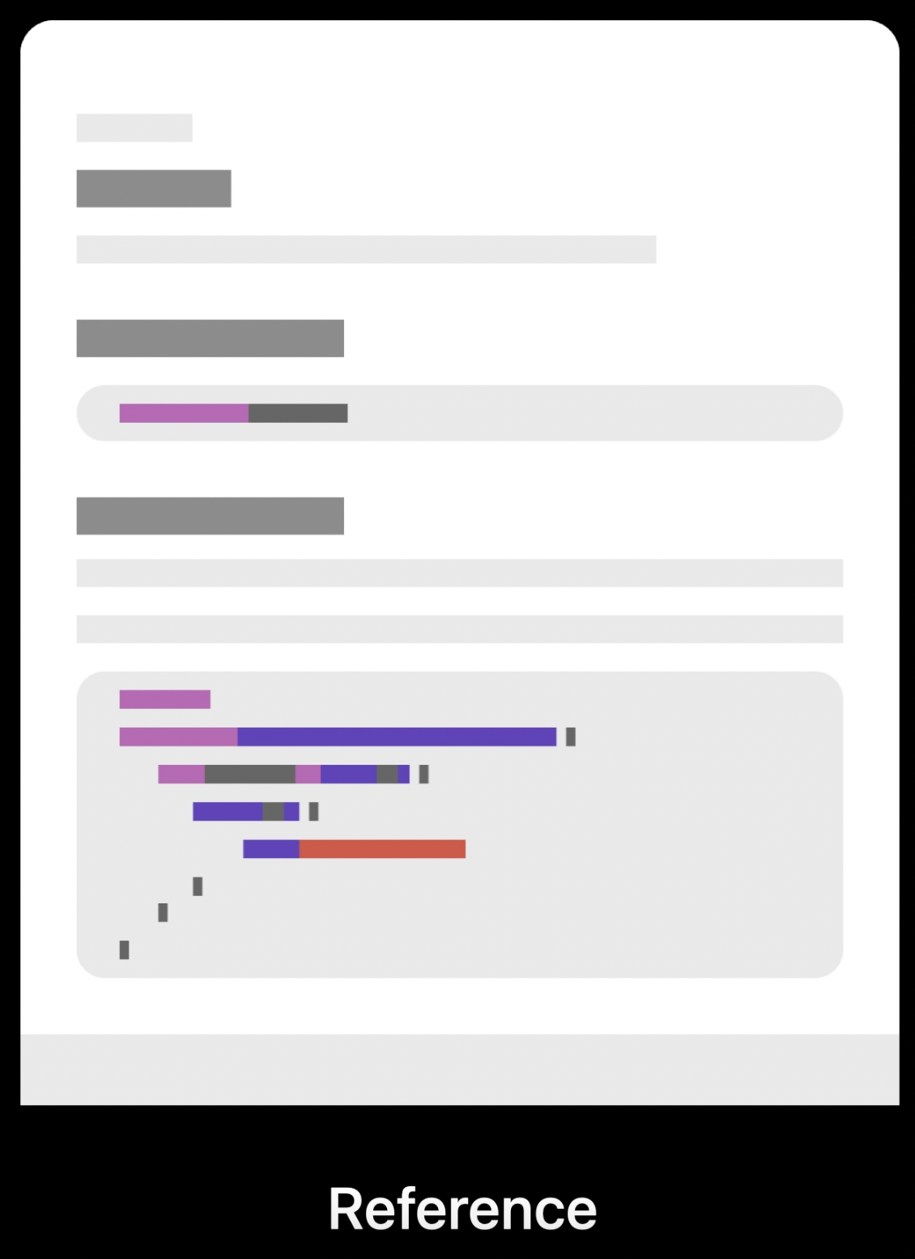
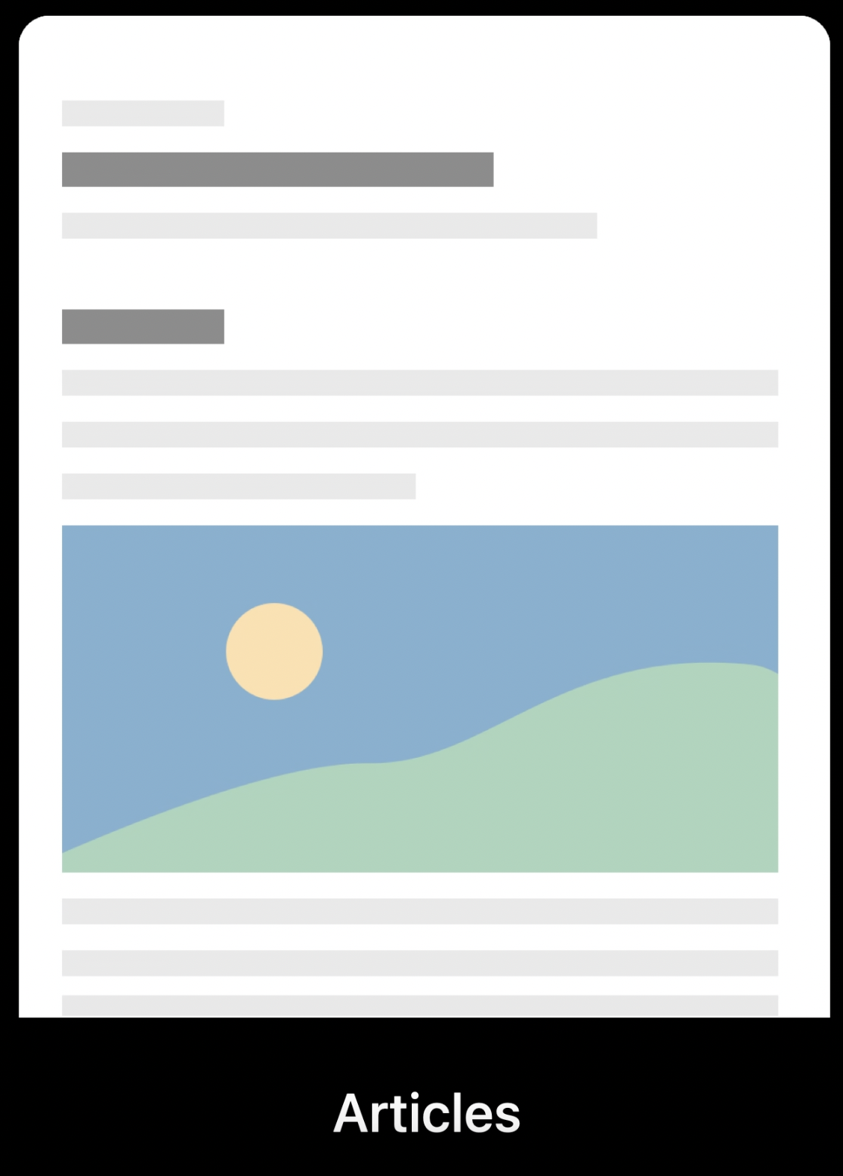
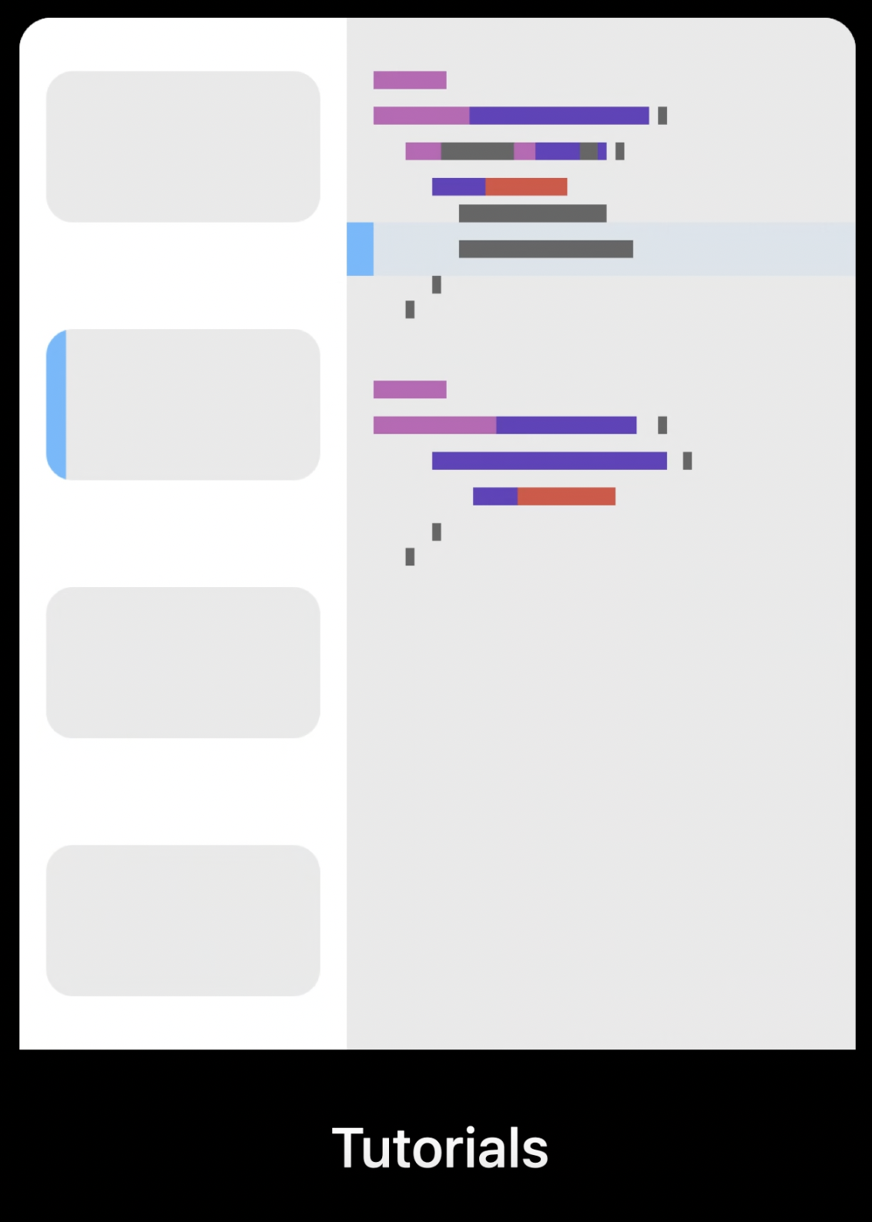
Three Page Types

Slide 10
Why Swift DocC?

Slide 11
Why DocC?
App In-House Product.
Creates documents for Swift, Objective-C or Mix-work.
Integrates into Xcode’s Source Editor.
Appears on Xcode Built-in documentation.
Anyone can access to your document who has the source code.
Xcode 15 brings rich experience of writing Swift-DocC documentation
Documentation Preview Editor gives you the Real time view with live rendering on every key stroke.
Allowing straight forward publishing to services like Github, etc.

Slide 12
Creating

Slide 13
Lets understand `creation` with Demo

Slide 14
Theming

Slide 15
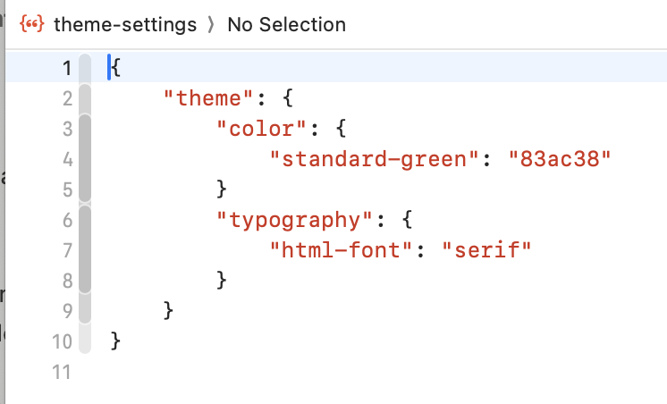
Theming
Site-wide Customisation
Theme customisation are site-wide Customisation
Deployment Specific
Swift-DocC themes are intentionally specific to a deployment.
Consider when to use theming and when to use metadata Directive
For customisation to appear on both Xcode and Web, use metadata directive.
Create JSON file with the specific name "theme-settings.json" and place into your project's documentation catalog.

Slide 16
Hosting documentation

Slide 17
Hosting documentation
Can be exported directly and share, so that anyone can import and read the documentation in Xcode.
Can host the documentation archive online.

Slide 18
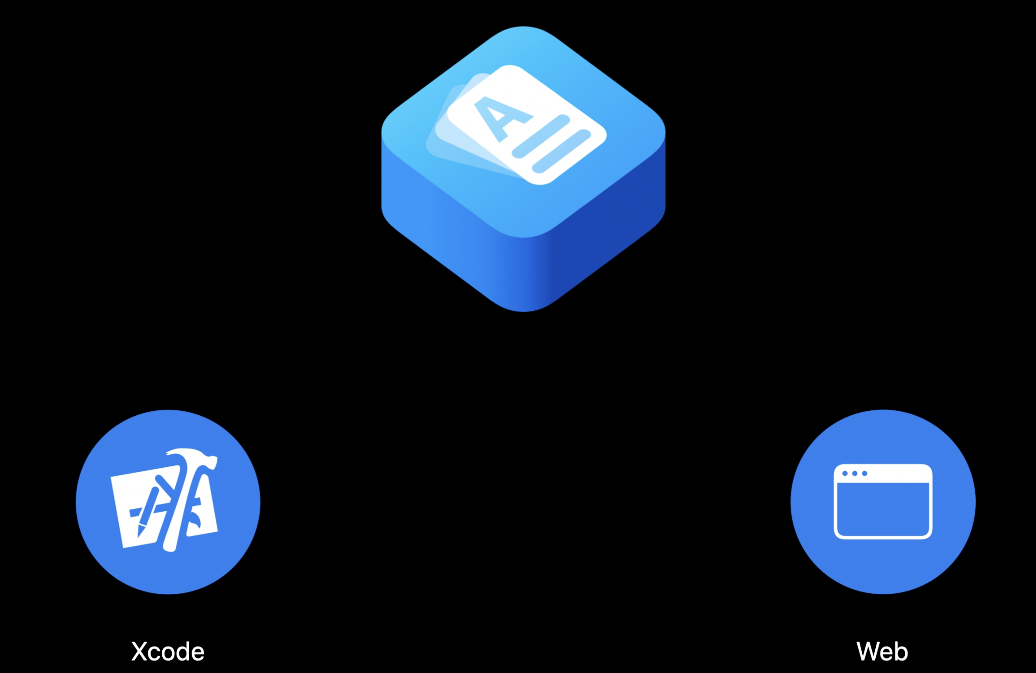
Documentation Archive
The documentation archive itself is a container that holds all the data to both read the documentation in Xcode and to host it online.

Slide 19
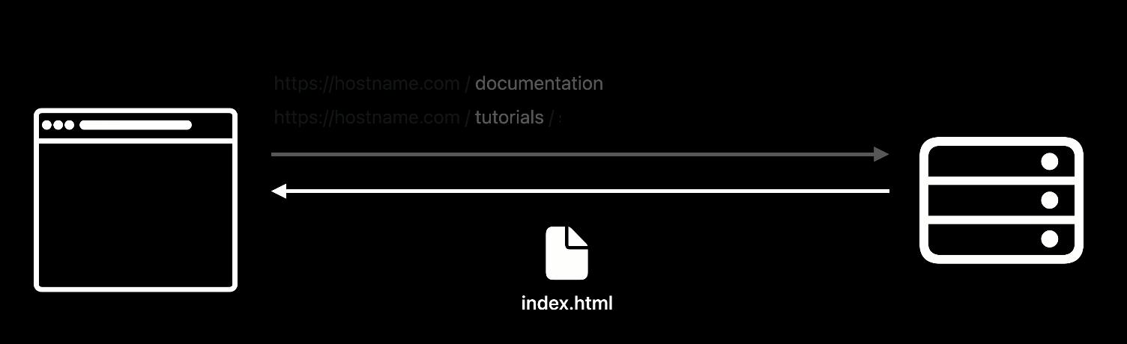
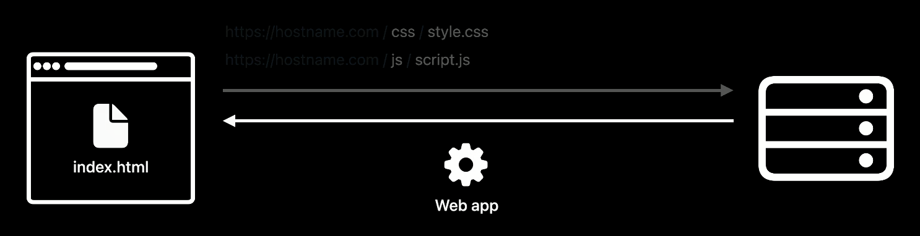
Two types of documentation request
There are two types of request which server needs to handle to host the documentation archive :
Request for documentation and tutorial.
Request for additional files and data that is loaded by web app.

Slide 20
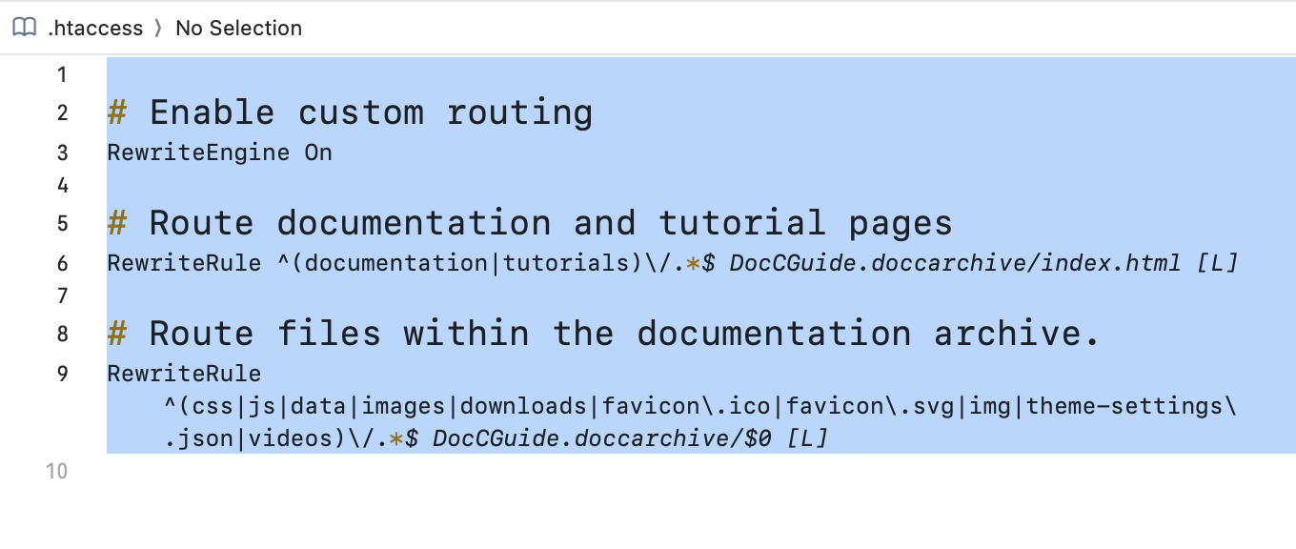
Hosting documentation
Copy the .doccarchive file into the directory where we are hosting the web site
Create .htaccess file and write rules as per below image

Slide 21
Automate Builds

Slide 22
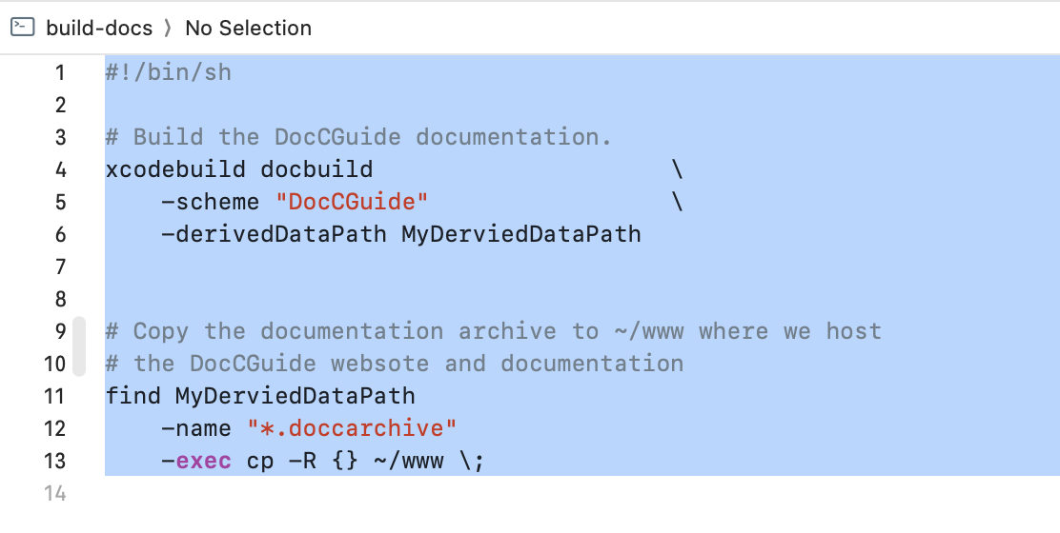
Automate Builds
Build documentation for the project.
Find all build document archives to copy them another location.
Create build-docs script file and add below code for your scheme name and derived path.

Slide 23

Shortcuts
To add documentation template for the function or property
Command + Shift + A then Search for “Add Documentation" and click
To build the documentation
Control + Shift + Command + D

Slide 24
I recommend reading Swift-DocC's documentation if you're interested in taking things further.
https://www.swift.org/documentation/docc
https://developer.apple.com/videos/play/wwdc2021/10166/
https://developer.apple.com/videos/play/wwdc2021/10167/
https://developer.apple.com/videos/play/wwdc2021/10235/
https://developer.apple.com/videos/play/wwdc2021/10236/
https://developer.apple.com/videos/play/wwdc2023/10244/

Slide 25
QnA
Thank you.

